Slide 1
LUCIDITY APP
This training is provided for employees downloading and using the Lucidity App for
Hazards and Incident

Slide 2


Introduction
The Lucidity App is available in iOS and Android and is available from the App Store and Google Play
  Search for Lucidity Software and download

Slide 3
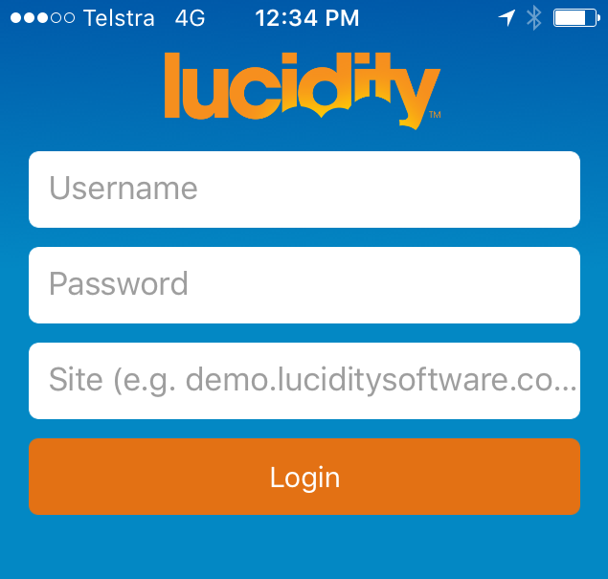
Logging into the App
Enter your Username and Password (the same details as you would use via a web browser).
In the Site field enter the url (address) of your site (e.g. demo.luciditysoftware.com.au)
Note: Don’t include the https:// when entering the url of your site.

Slide 4
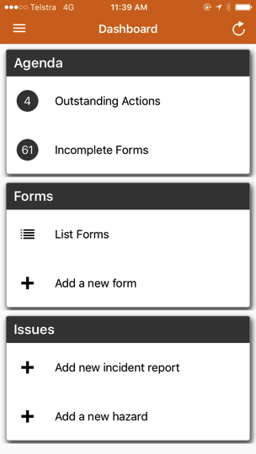
The Dashboard
Once logged in, you will be taken to your Dashboard
From the Dashboard you can:
  Manage your Actions
  Report an Incident
  Report a Hazard

Slide 5
Refresh
The Lucidity App periodically refreshes all information that is stored on the mobile device, however a refresh icon is also provided (top right). Tapping this icon will do the following:
All hazards and incidents are automatically synced with the database when they are saved on the mobile device.

Slide 6
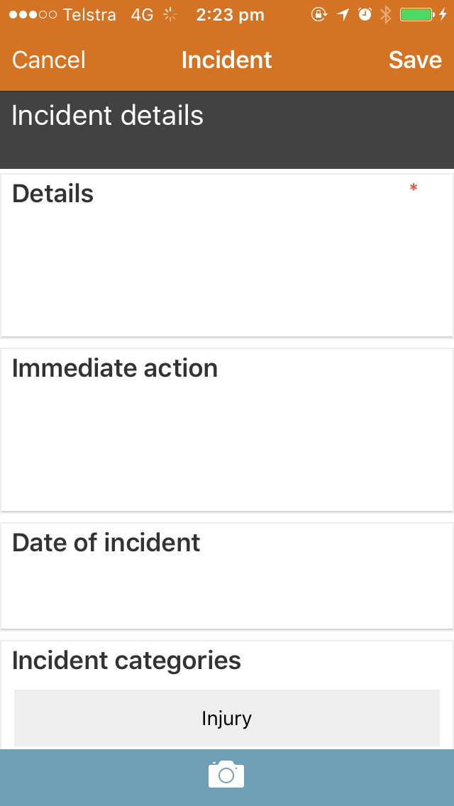
Report an Incident
Tap the Add new Incident Report link via the Dashboard.
Complete the Incident report with as much detail as you can.

Slide 7
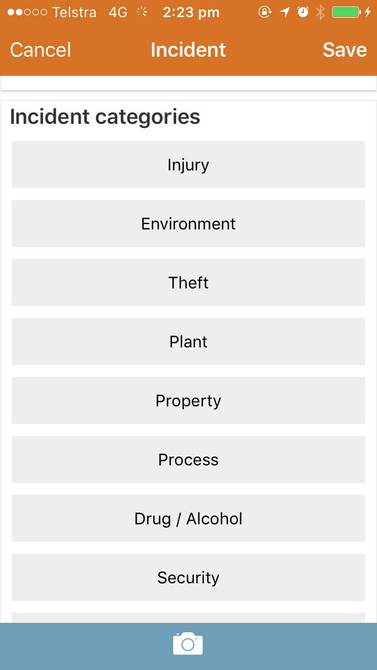
Report an Incident
Select the Incident Category from the available list.
Select the Actual Incident classification.
Select the Potential Incident classification.
Complete the Org Structure details and click Save.

Slide 8
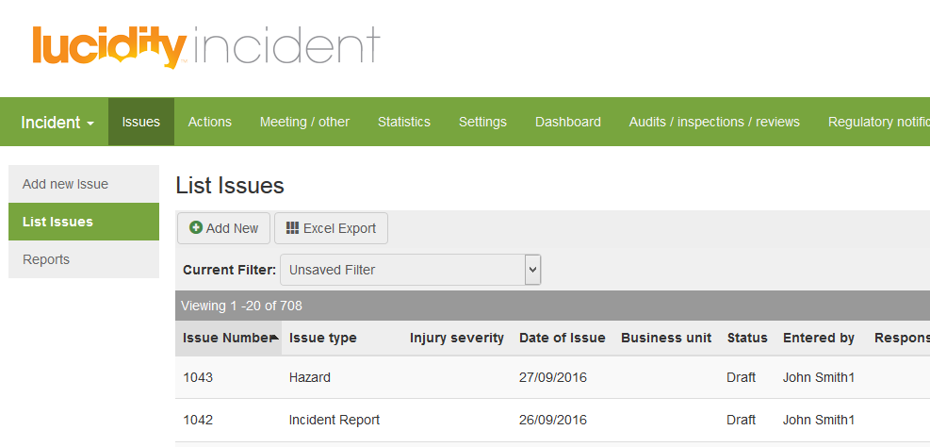
Report an Incident
The Incident Report will be saved as a Draft and is accessible via Lucidity Incident for further investigation and follow up

Slide 9
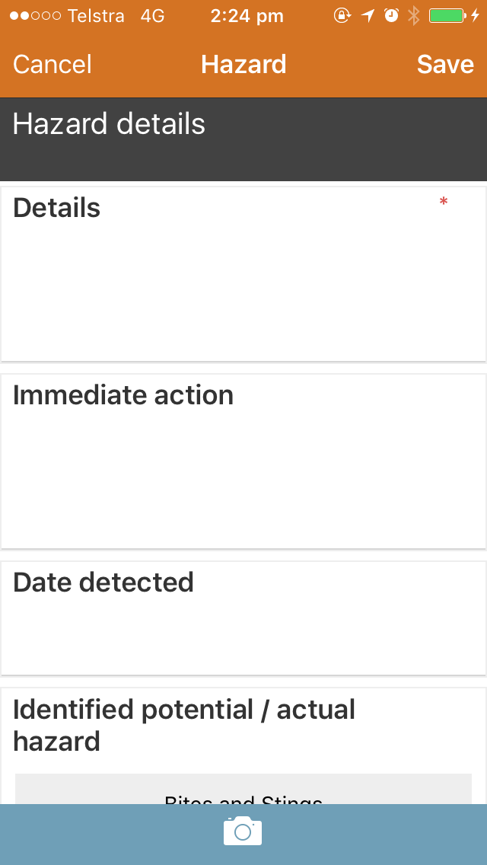
Report a Hazard
Tap the Add a new Hazard link via the Dashboard.
Complete the Hazard report with as much detail as you can.

Slide 10
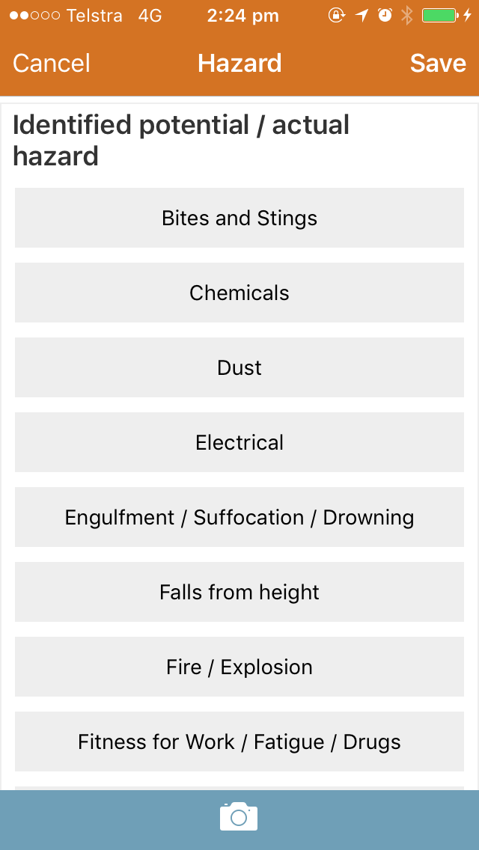
Report a Hazard
Select the potential / actual identified hazard from the list provided.
Indicate if further actions are required.
Complete the Org Structure details and click Save.

Slide 11
Report a Hazard
The Hazard Report will be saved as a Draft and is accessible via Lucidity Incident for further investigation and follow up

Slide 12
Add a Photo
Click to bring up the ‘add photo’ screen

Slide 13
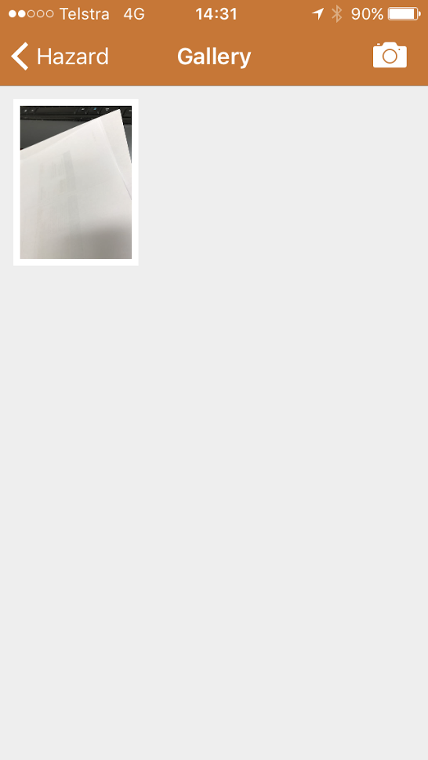
Add a Photo
Click the camera icon to add the image

Slide 14
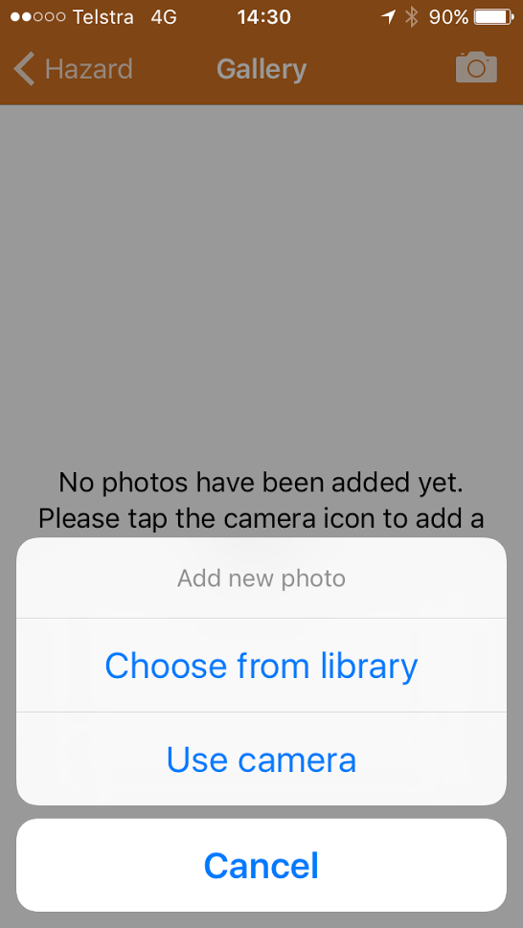
Add a Photo
Either choose an image from the library, or use take a photo

Slide 15
Menu
Menu

Slide 16
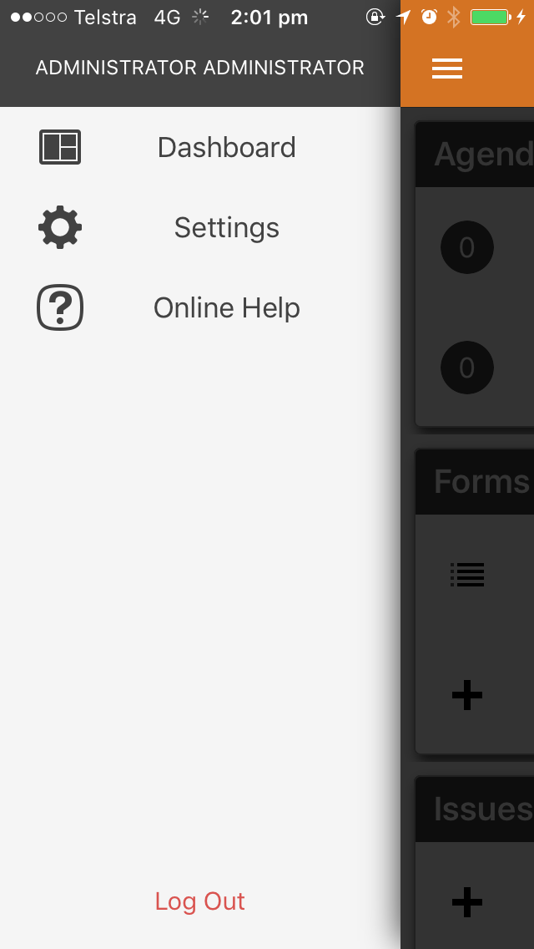
Menu
Tap the button at the top left to display the menu.
Settings
The settings menu item displays the current version of the Lucidity App that is on the device, and the site the device is logged in to.
Online Help
Tap to access online help

Slide 17
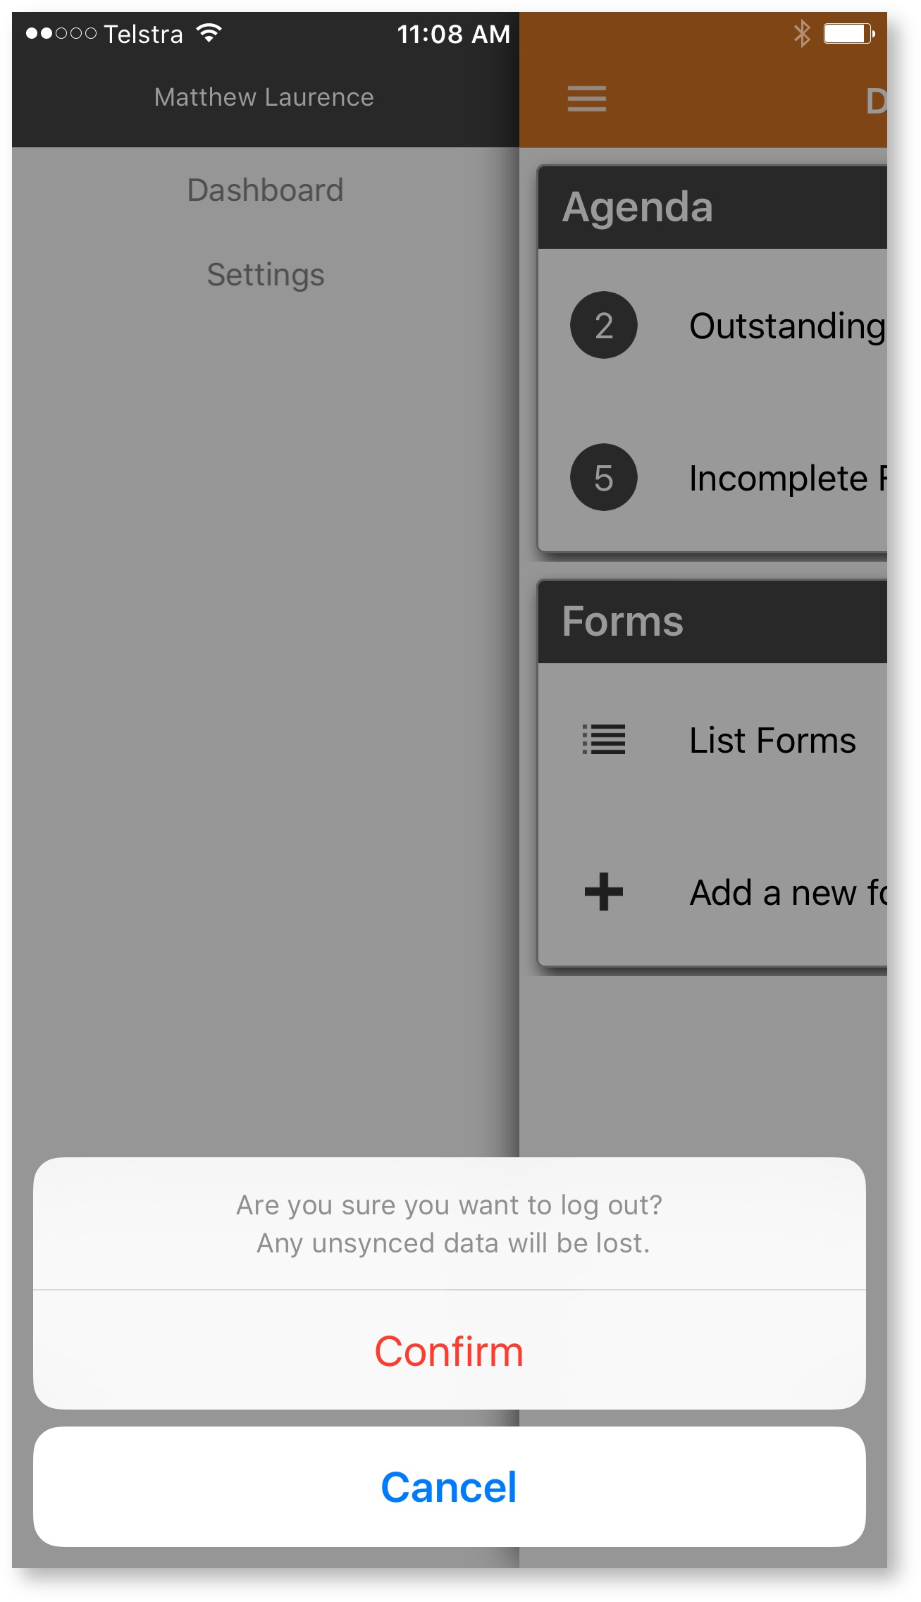
Menu
Logging Out
Tap the Log Out button at the bottom of the menu and then choose confirm. Any unsynchronised changes will be lost.

Slide 18
Offline Mode
The Lucidity App will store data for hazards and incidents while the mobile device is out of range. When the device is back in range, it will sync newly created hazards / incidents with the database.

Slide 19
THANK YOU
You have completed this training package

