Slide 1
INTRODUCTION
This training provides an overview of the Lucidity Software products

Slide 2
Introduction
Lucidity Software provides one centralised solution for capturing information regarding:
  business processes
  health, safety, quality and environmental systems
  training and people development
  reporting and measuring outcomes of business processes

Slide 3
Modular Systems
Lucidity is a suite of applications, which your company is implementing:
  either as individual Modules, or
  as a fully integrated system
  over time, to meet your company’s needs

Slide 4
Lucidity Modules
Your company will be implementing a combination of the following Modules:
  Lucidity Intranet
  Lucidity Incident
  Lucidity Learning
  Lucidity Risk
  Lucidity InForm
  Lucidity Asset

Slide 5
Logging into Lucidity
There are three ways to log into Lucidity:
  Directly into one of the Modules,
  Via the Switch Application Feature from another Module, or
  Using the Mobile App

Slide 6
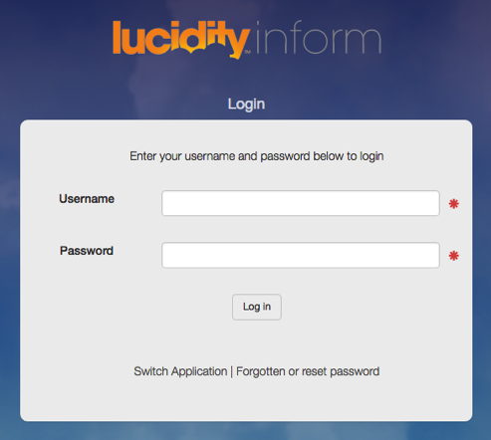
Login Directly
Login directly to the Module
using your:
Username, and
Password
OR

Slide 7
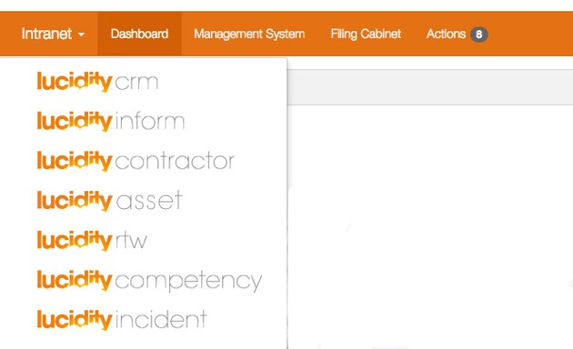
Access from another Application
Use the Switcher to change from other Applications
OR

Slide 8
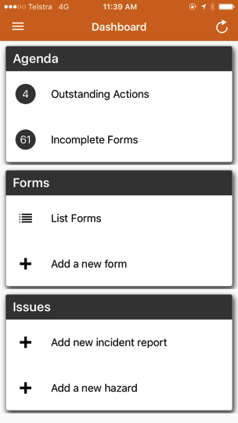
Access from the mobile App

Slide 9
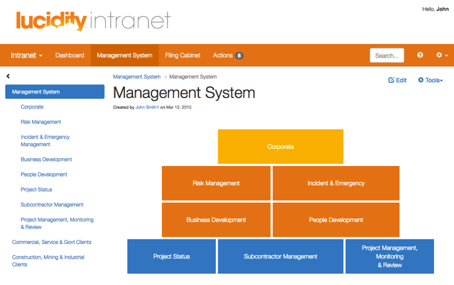
Using Lucidity Software
There is training available for each module
Additionally, there is Online Help available for each Module

Slide 10
THANK YOU
You have completed this training package

