Slide 1
LUCIDITY INCIDENT
This training is provided for employees logging issues through Lucidity Incident

Slide 2
Introduction
Lucidity Incident allows your employer to record, investigate and manage issues.
Types of issues that can be recorded include:
  incidents
  non-conformances
  hazards
  complaints
  improvements

Slide 3
Introduction
Log an Incident when there is any event, product, process or circumstance that could cause harm to a person, property or the environment.
Log a Non-conformance when there is any failure of a product, process or work standing resulting in a need for analysis and remedial action.
Log a Hazard when there is any activity or anything with a potential to cause harm to a person, property or the environment.
Log a Complaint when there has been a formal objection from a client, stakeholder or regulator.
Log an Improvement Opportunity when you identify a product, process or activity where there is an opportunity to improve productivity, quality, safety or environmental outcomes.

Slide 4
Introduction
There are two ways to log in to Lucidity Incident
  Directly into the Module, or
  Using the Mobile App

Slide 5
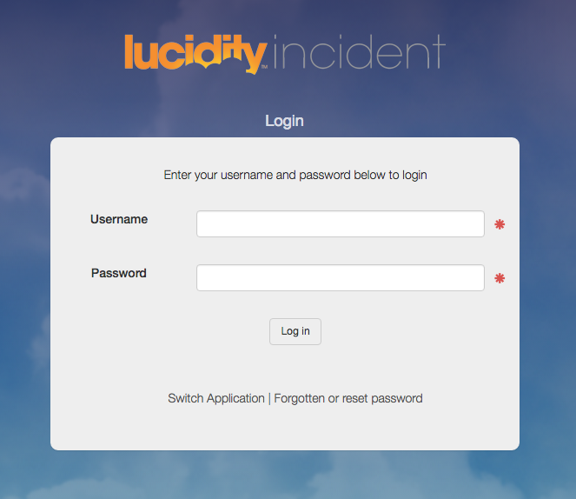
Introduction
Login directly to Incident using your:
Username
Password
OR

Slide 6
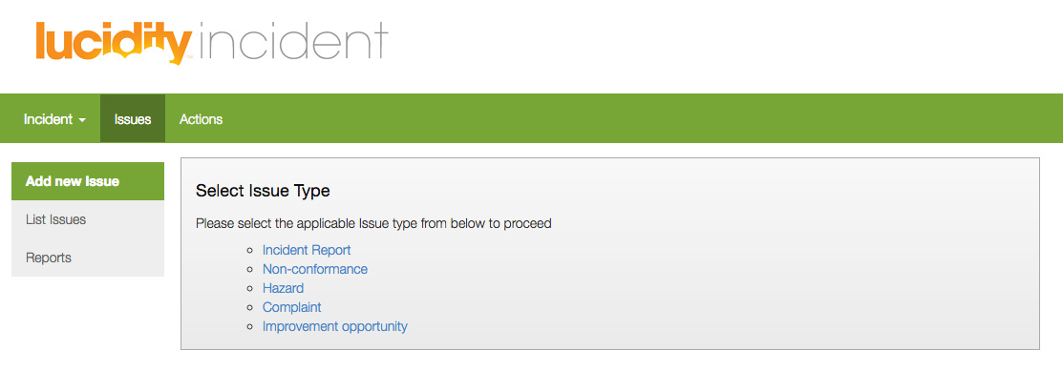
Logging an Incident Report
Click on Incident Report in the Select Issue Type box

Slide 7
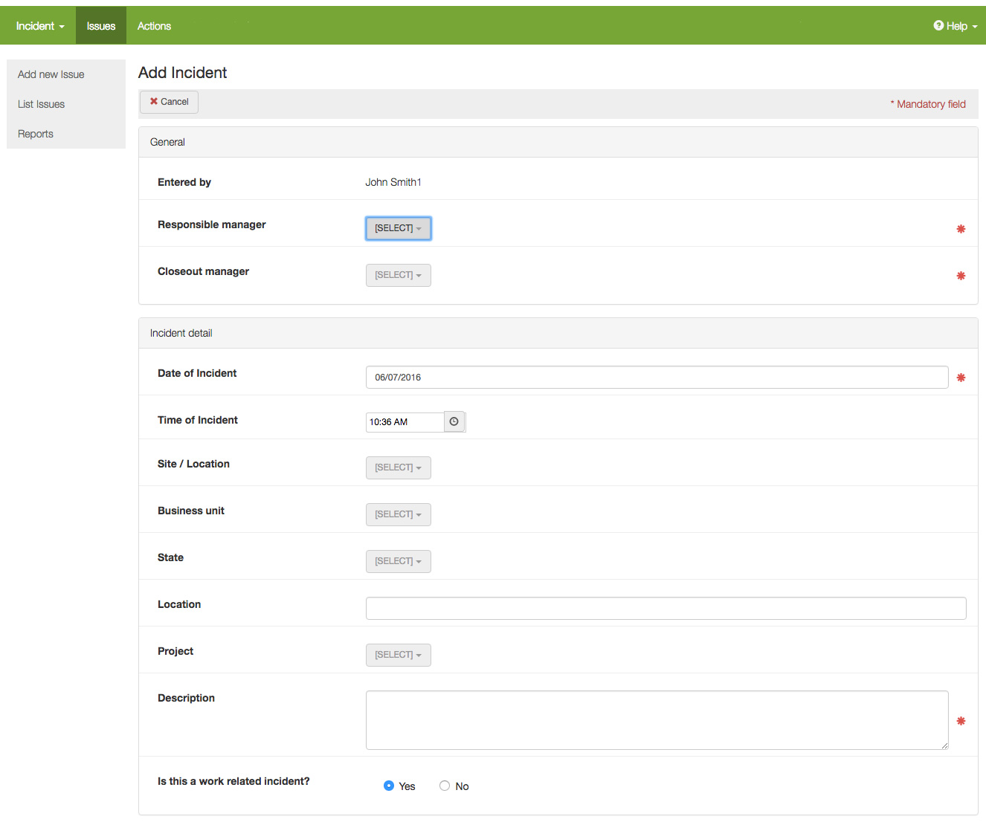
Incident Report - General
Choose Managers from the drop-down lists
A red asterix means the field is mandatory
Record as much information as you can. The more details you can include the better.

Slide 8
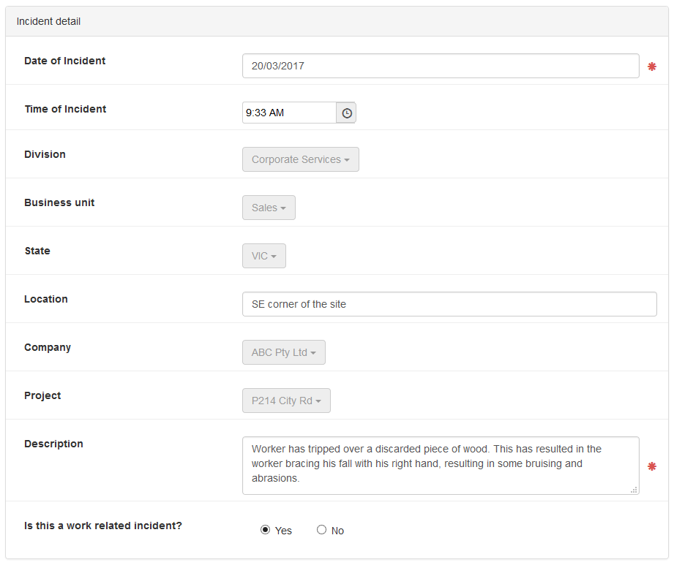
Incident Report – Incident Detail
Enter as much detail as possible:
Time
Location
Description (This may be carried over to the Injury Report)

Slide 9
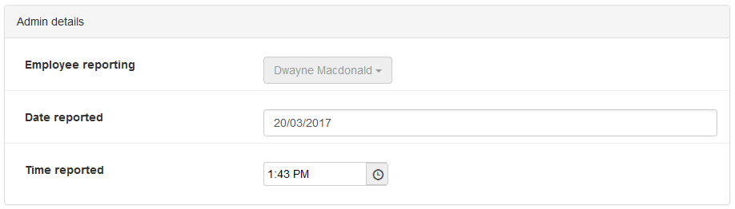
Incident Report – Admin
Complete Employee Reporting, date and time reported

Slide 10
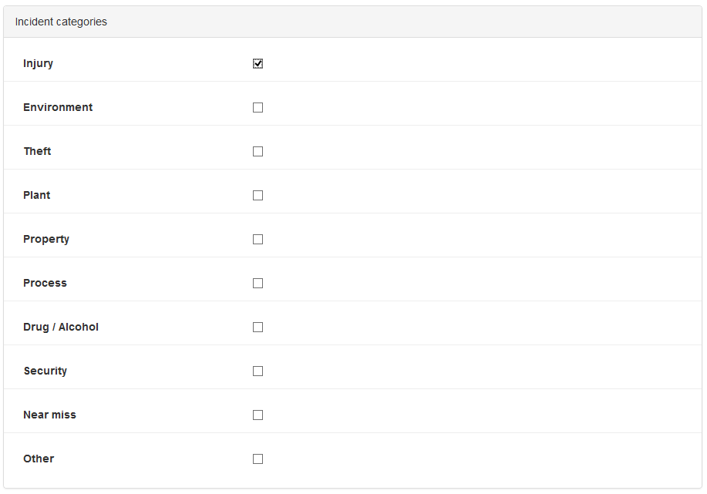
Incident Report – Categories
Each individual Incident Category checked will add a report to be completed
You can select more than one Category

Slide 11
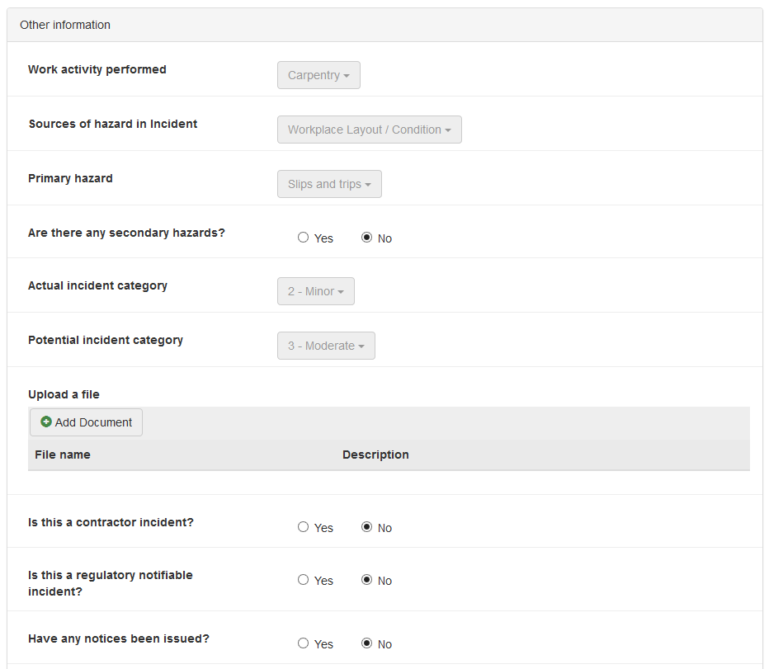
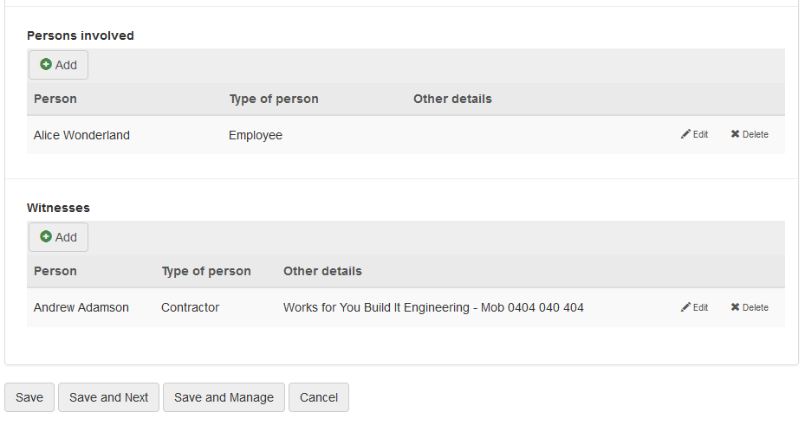
Incident Report – Other Information
Enter as much detail as possible:
Work Activity performed
Sources of Hazard
Actual and Potential Hazard
Upload a file / picture / written statement
Persons involved
Witnesses
Click Save and Next to go to the next page

Slide 12
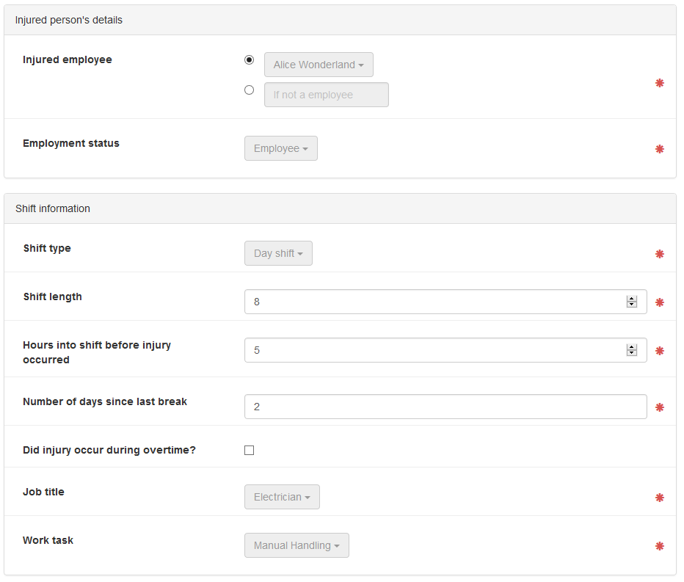
Incident Report – Injury Report
Enter employee details (may also be a member of the public)
Enter employee shift information

Slide 13
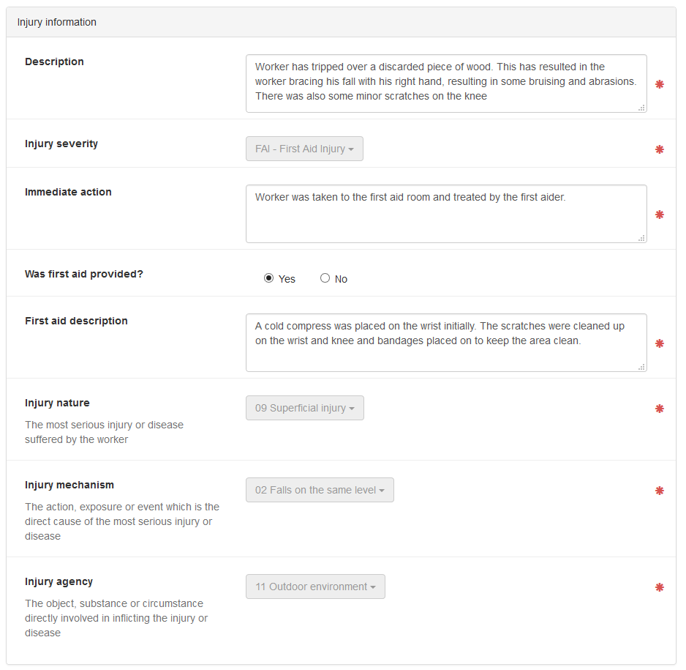
Incident Report – Injury Report
Enter details about the injury:
Actions taken
First aid provided
Injury details

Slide 14
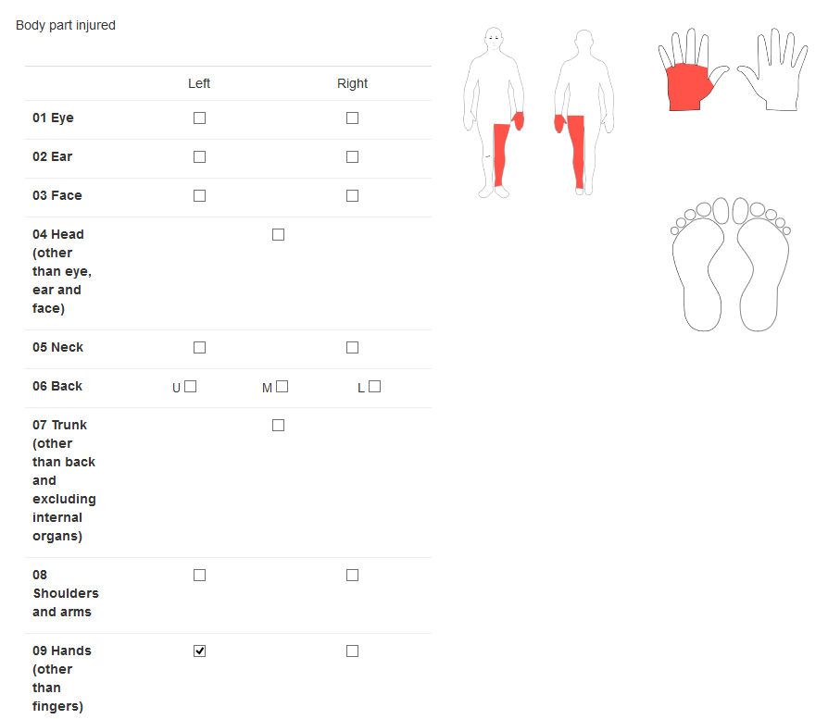
Incident Report – Injury Report
Injury Information is entered here.
Select the body part/s injured
Save and add another injury

Slide 15
Logging an Incident Report
Your role in logging an Issue is now complete
Once an issue is logged, an email notification will be sent to the Responsible Manager for review and action

Slide 16
Managing the Incident
The Responsible Manager will now approve the issue. This involves:
  performing a causal analysis to establish why the issue occurred, and how to stop it happening again,
  allocating appropriate Actions, and
  other steps as appropriate

Slide 17
Logging other Issues
Follow the same steps to record other
types of Issues

Slide 18
THANK YOU
You have completed this training package

