Slide 1
LUCIDITY INCIDENT
This training is provided for employees logging issues through Lucidity Incident

Slide 2
Introduction
Lucidity Incident allows your employer to record, investigate and manage issues.
Types of issues include:
  incidents
  non-conformances
  hazards
  complaints
  improvements

Slide 3
Introduction
There are three ways to log in to Lucidity Incident
  Directly into the Module,
  Via the Switch Application Feature, or
  Using the Mobile App

Slide 4
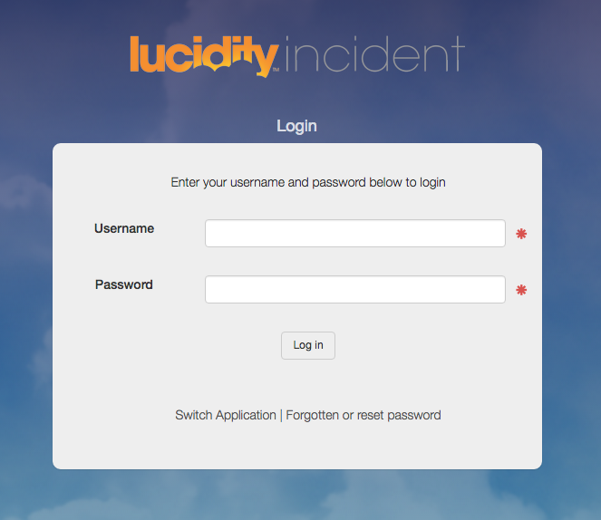
Login Directly
Login directly to Incident using your:
Username
Password
OR

Slide 5
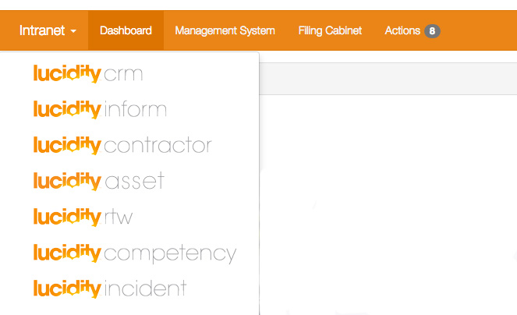
Access from another Application
Use the Switcher to change to other Applications
OR

Slide 6
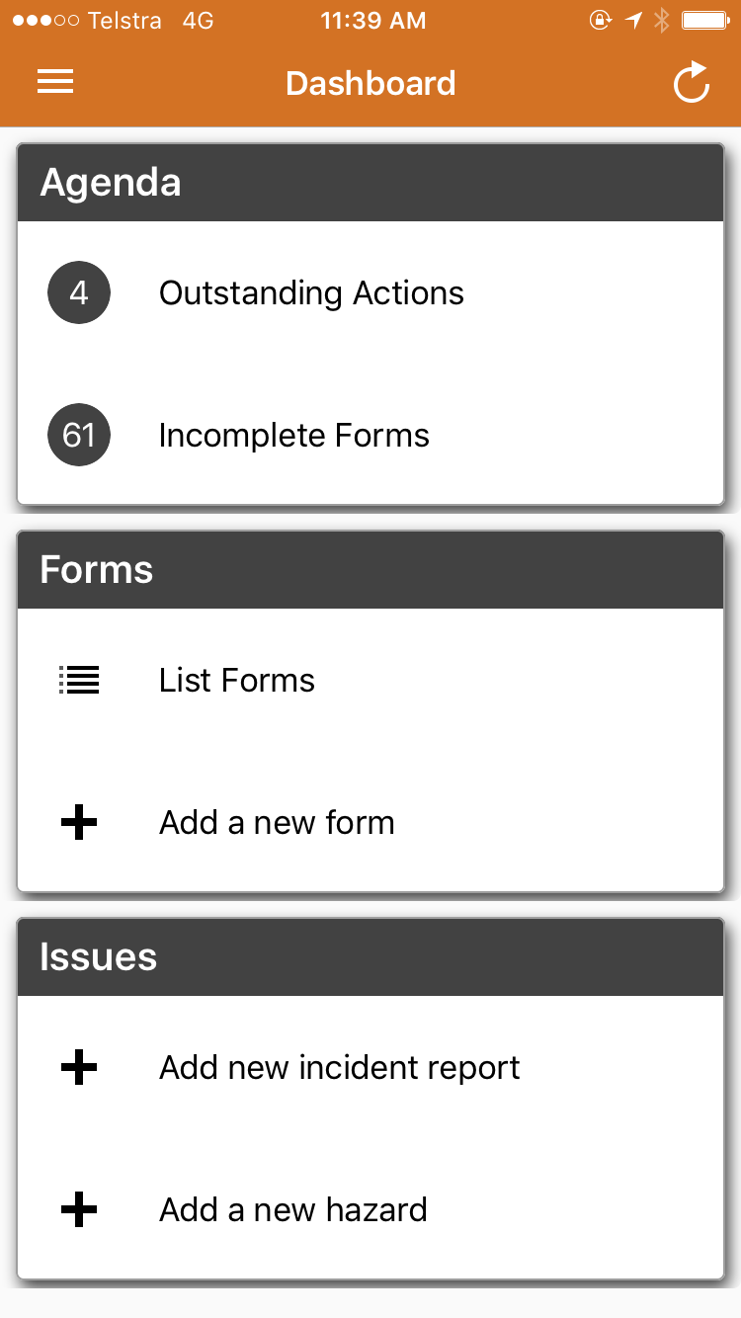
Access from the mobile App
Add an Incident or Hazard via the
mobile app

Slide 7
Using Incident
Lucidity Incident enables you to:
  Log an Issue
  Manage existing Issues (if you have appropriate permissions)

Slide 8
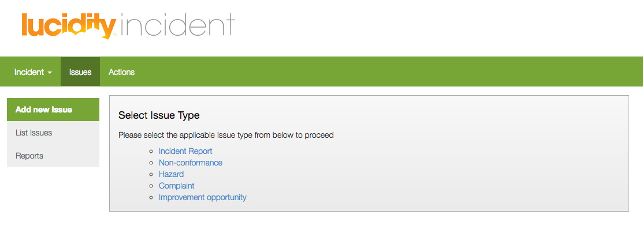
Logging an Issue
Click on the appropriate Issue type and follow-the prompts

Slide 9
What type of Issue?
Log an Incident when there is any event, product, process or circumstance that could cause harm to a person, property or the environment.
Log a Non-conformance when there is any failure of a product, process or work standing resulting in a need for analysis and remedial action.
Log a Hazard when there is any activity or anything with a potential to cause harm to a person, property or the environment.
Log a Complaint when there has been a formal objection from a client, stakeholder or regulator.
Log an Improvement Opportunity when you identify a product, process or activity where there is an opportunity to improve productivity, quality, safety or environmental outcomes.

Slide 10
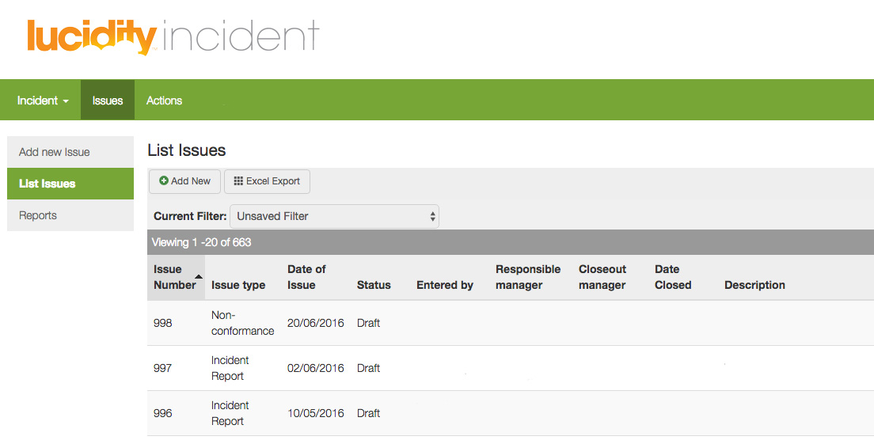
View existing Issues
Click on List Issues to view a list of existing Issues

Slide 11
THANK YOU
You have completed this training package

