Slide 1
LUCIDITY COMPETENCY
This training is provided for Managers using Lucidity Competency to view employee / contractor records

Slide 2
Introduction
In Lucidity Competency, records of training, licences, certificates and other capabilities are stored for employees and contractors.
You can search for:
  Records for an individual person
  A list of people who have a capability

Slide 3
Search for Records
There are two ways to search for a person’s records:
  Via the person’s name under People
  Via the Records tab

Slide 4
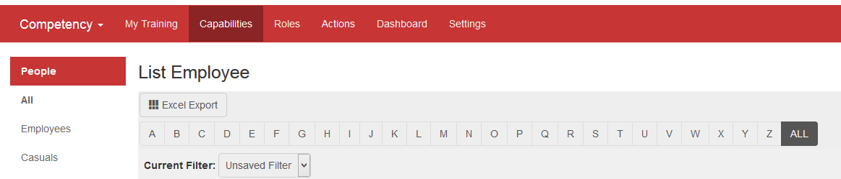
Search for Records by Person
To view a person’s records under ‘People’:
  Click on the Capabilities tab, then click on People in the left hand list
  Either use the filter function to search for the person or click on the alphabet to bring up a list

Slide 5
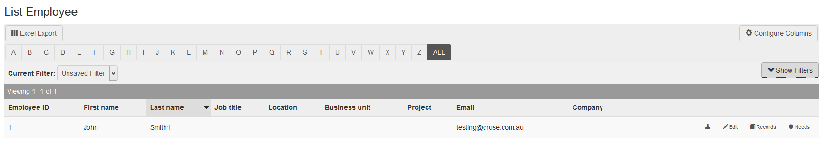
View Records for a Person
Locate the person and click on the Records button
Click Records to display their records

Slide 6
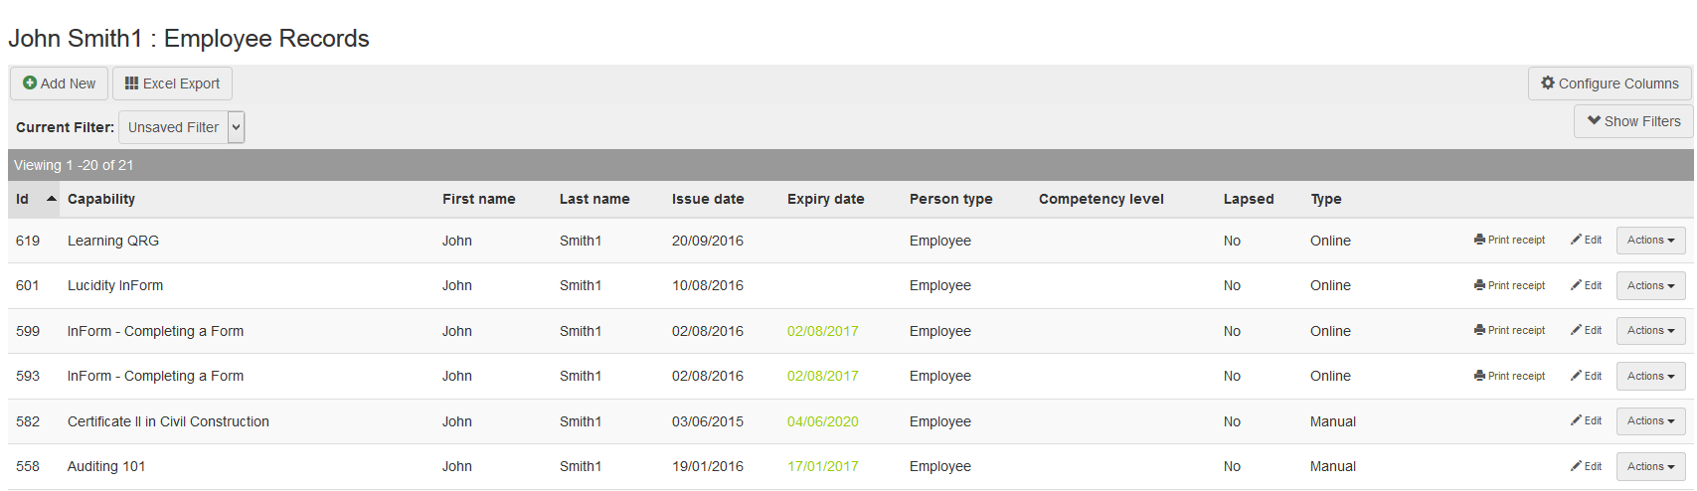
View Records for a Person
The list of records for the person will be displayed
Click Edit to view details of record

Slide 7
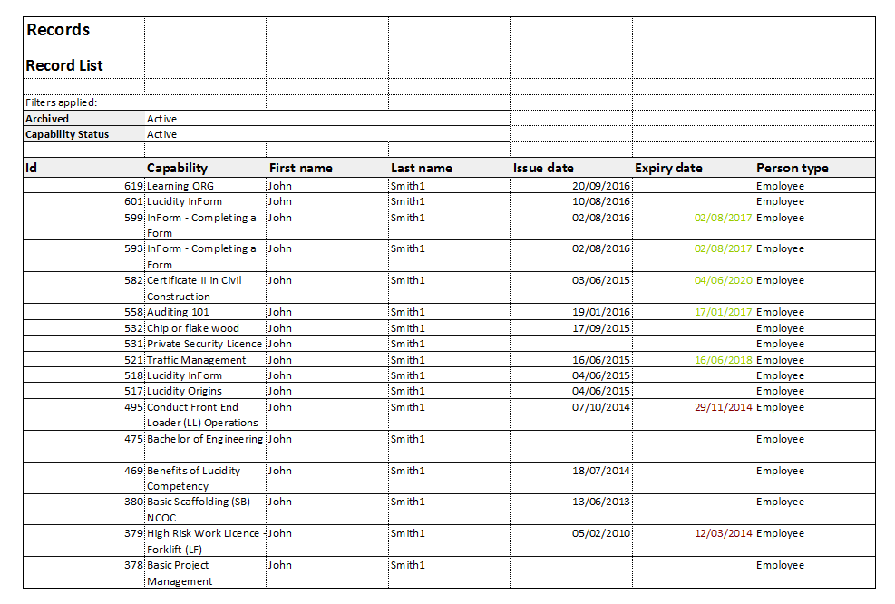
Reporting
An Excel Report can be generated from the list of records

Slide 8
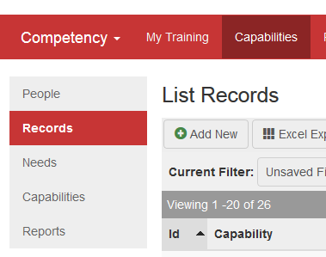
View Records for a Person
To view a person’s records under Records:
  Click on the Capabilities tab, then click on Records in the left hand list
  Use the filter function to search for the employee

Slide 9
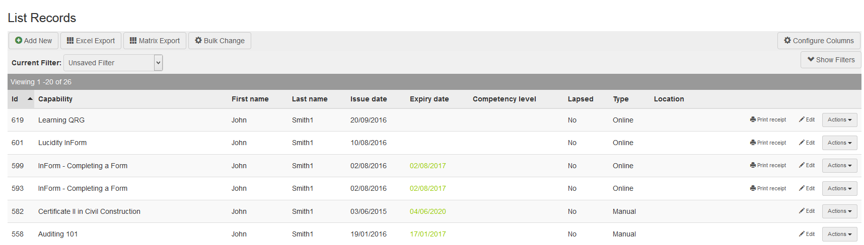
View Records for a Person
The list of records for the person will be displayed

Slide 10
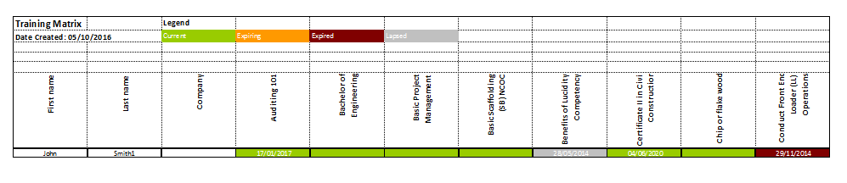
Reporting
An Excel Report or Matrix Report can be generated from the list of records

Slide 11
View Records by Capability
To generate a list of people that have completed a Capability:
  Click on the Capabilities tab, then click on Records

Slide 12
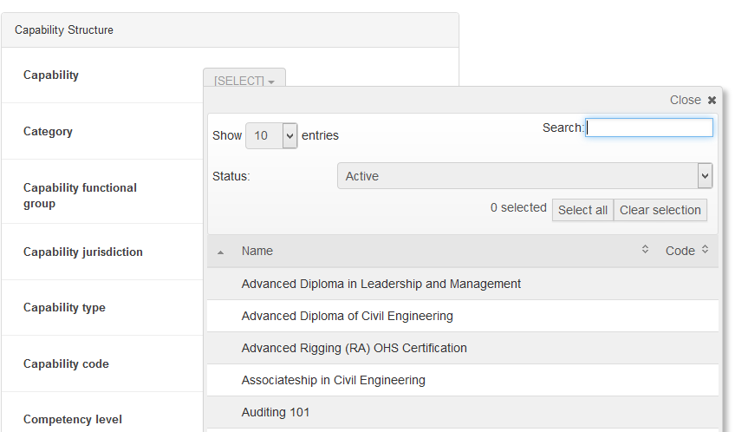
View Records by Capability
Use the Filter option to select the Capability

Slide 13
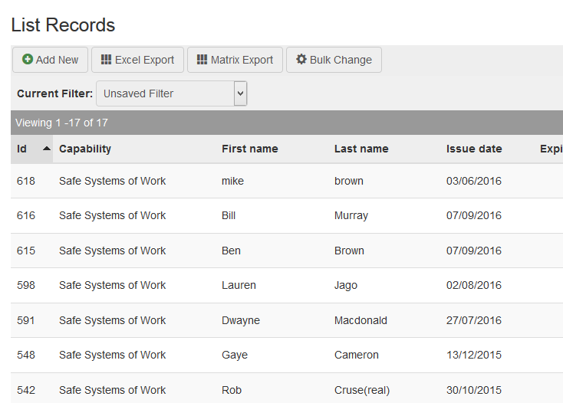
View Records by Capability
A list will be generated for all people who have that capability

Slide 14
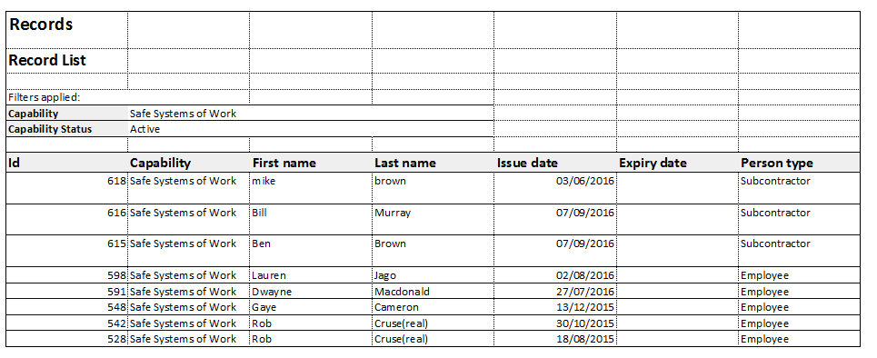
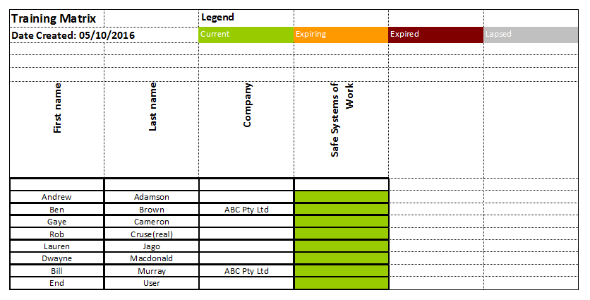
Reporting
An Excel Report or Matrix Report can be generated from the list of records

Slide 15
THANK YOU
You have completed this training package

