Slide 1
LUCIDITY CONTRACTOR
This training is provided for employees using
Lucidity Contractor

Slide 2
Introduction
Lucidity Contractor allows you to manage your Contractor records.
Including:
  delivering online training
  keeping records of training, licences, certificates and other competencies
  reporting on outstanding training

Slide 3
Introduction
There are two ways to login to Lucidity Contractor
  Directly into the module itself, or
  Via the Switch Application Feature

Slide 4
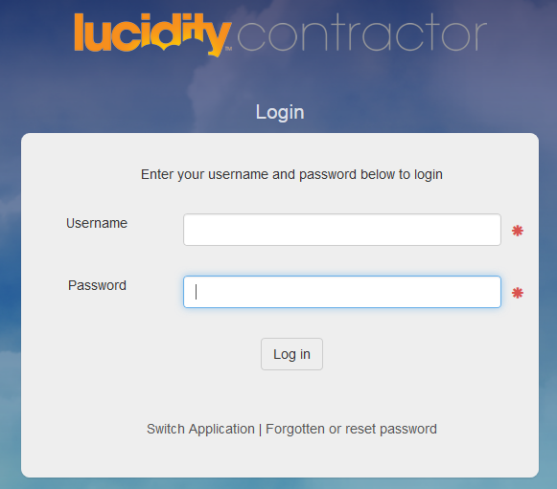
Login Directly
Login directly to Contractor using your:
Username
Password
OR

Slide 5
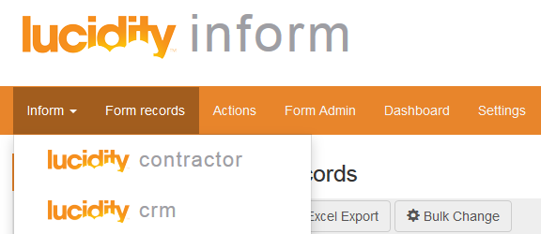
Access from another Application
Use the Switcher to change to other Applications

Slide 6
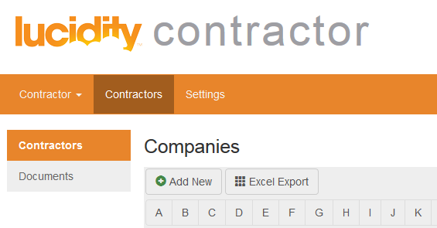
Using Contractor
Lucidity Contractor enables you to:
View Contractor Records
View Contractor Documents

Slide 7
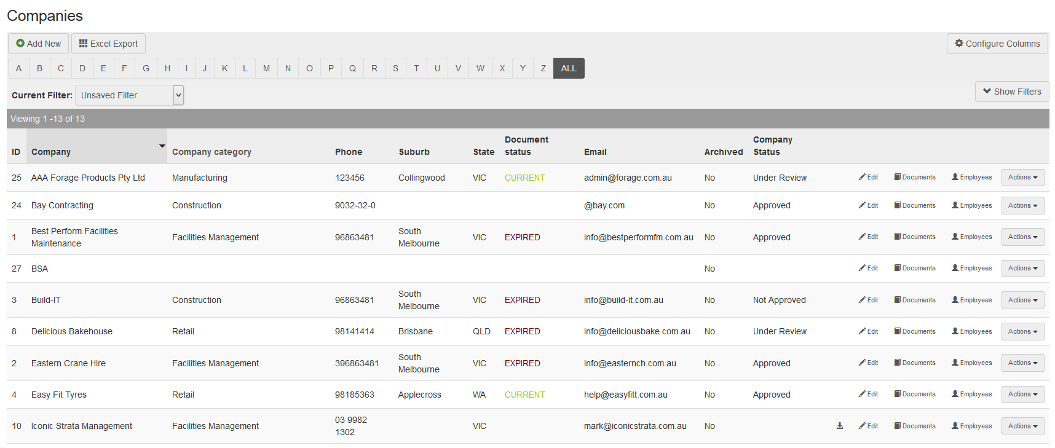
Using Contractor
The main screen for Contractor provides a list of the contractors currently on the system
  Like all Lucidity products, there are comprehensive filters to refine the list and produce reports, as well as MyEmails and MyFilters functions.

Slide 8
Using Contractor
  Note the following features:
  Colour coded record status
  Sortable columns (click column main heading)
  Direct access to details for records via “Documents” link
  Access to filters via the “Show Filters” button

Slide 9
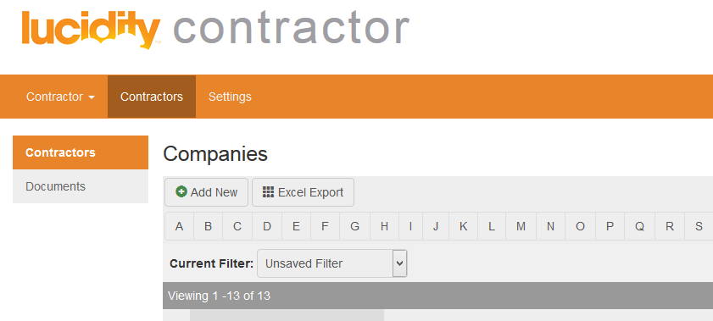
Adding a new Company
Click Add New to open the contractor administration form

Slide 10
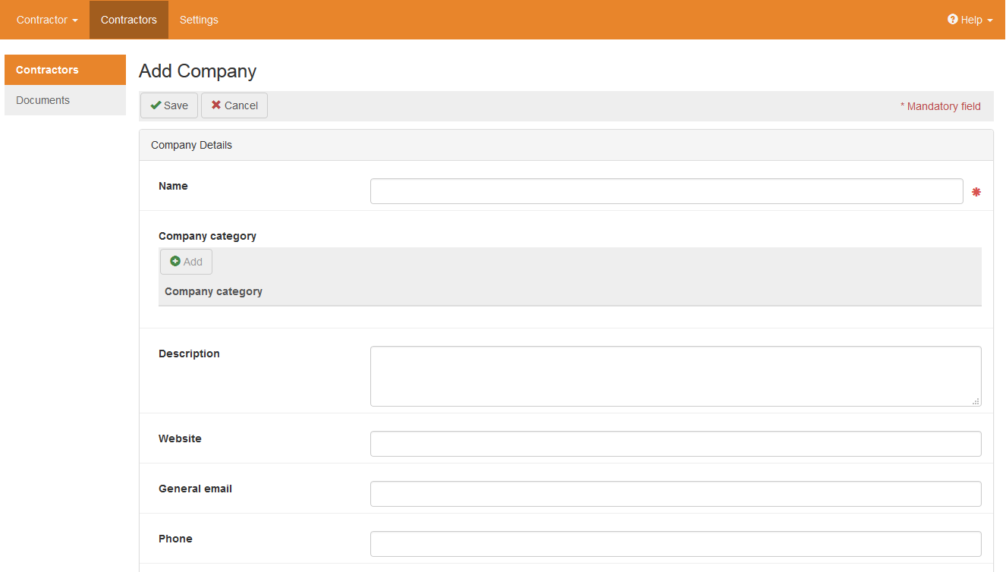
Adding a new Company
Enter the Company Name and other information of the Contractor business
Add information about the type of Goods and Services Supplied by selecting from the Category in the drop down list
If the Category does not appear in the drop down list, an Administrator can add this via the “Settings” tab

Slide 11
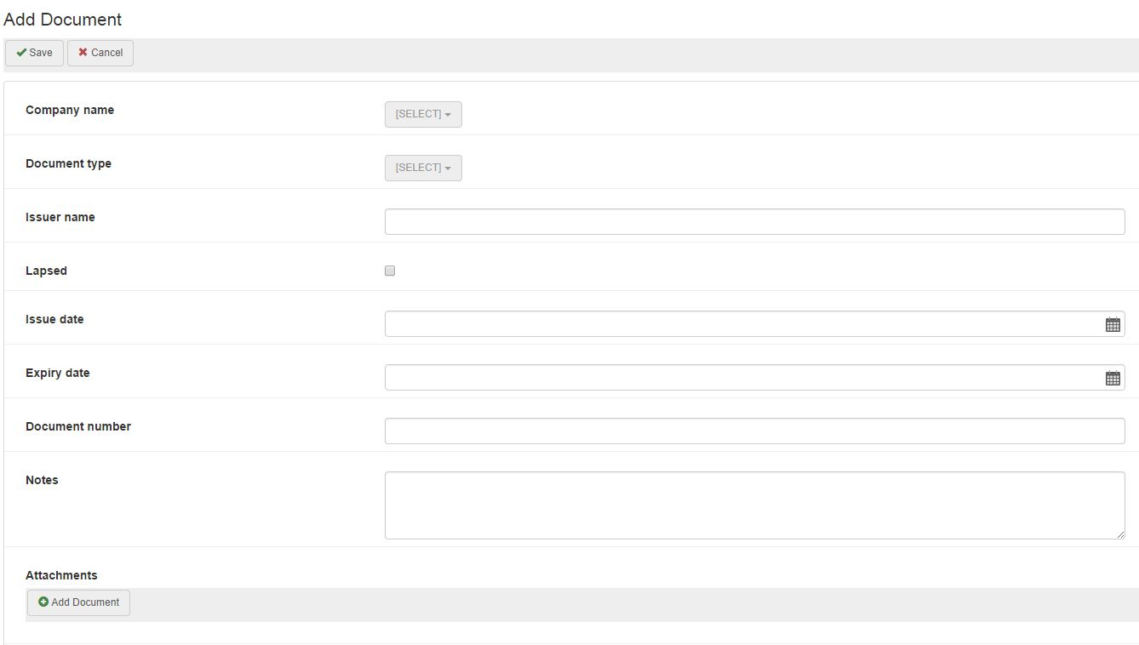
Adding a Document (Insurance, Permits, Licences)
Any required records can be added to the system by using the Add New Document function under the 'Document' menu.
Select the document type from the drop down list. Attach copes of records by clicking Add document under Attachments
Click upload once the document has been selected, then click Save
Any extra information can be recorded in the Notes field

Slide 12
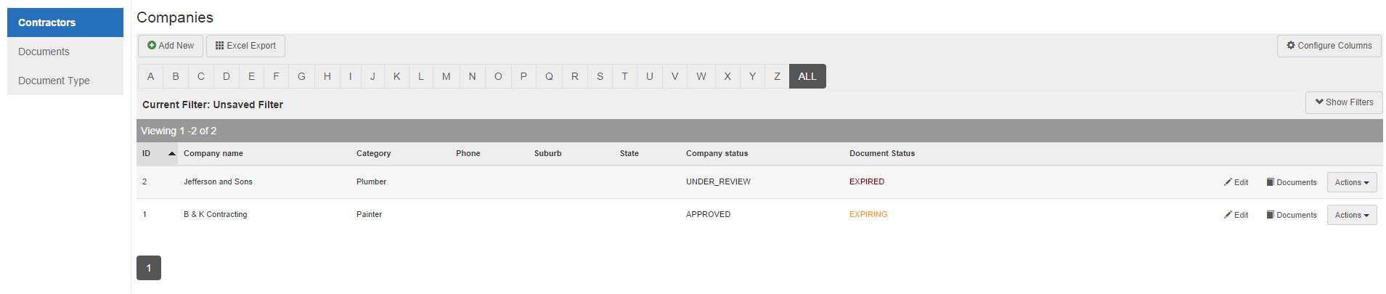
Managing existing Records
By clicking on the Contractors menu, all contractor records already in the system can be reviewed and modified. This is a list of all contractors in the system.
This list can be filtered by clicking the Filter button after making selections in the drop down filter fields

Slide 13
Managing existing Records
Filter selections fields include:
  Company Document Status
  Category
  State
This allows you to refine the search for contractors based on a particular criteria.
For example – you can search for contractors that provide security services

Slide 14
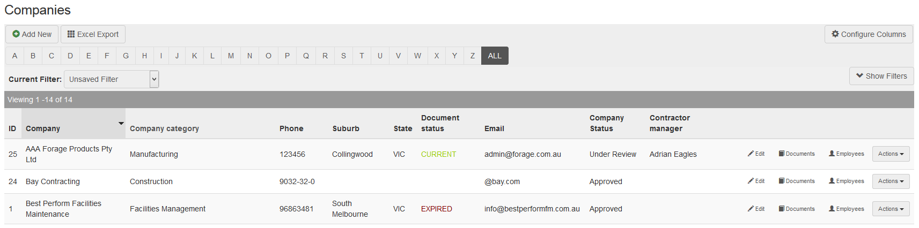
Managing existing Records
The list can be sorted by clicking on any column heading
Entries can be deleted by selecting an entry via the Actions button

Slide 15
Managing Existing Records
If an expiry date was recorded against a record, then the Record Status / Next Expiry column will:
  Turn Red when the expiry date has passed. The status column will display the Expiry Date
  Turn Orange one month prior to the expiry date – alerting users and managers of the imminent expiration
  Remain Green at all other times with the relevant expiry date
Existing entries can be Edited by clicking the pencil in the last column of the list table.
Remember to click Save at the end of each edit session

Slide 16
Settings
The following configurable dropdown lists are managed via the Settings tab:
  Company Category
  Company Status
  Document Category
  States
  Countries
These can be amended by the Administrator.

Slide 17
THANK YOU
You have completed this training package

