Slide 1
LUCIDITY INFORM
This training is provided for employees completing forms through InForm

Slide 2
Introduction
Lucidity InForm allows your employer to create online forms such as:
  inspections
  plant pre-start checklists
  toolbox meetings
  purchase order forms

Slide 3
Introduction
These forms can then be completed by you either:
  via any device with an internet connection, such as a laptop, tablet or mobile, or
  via the Lucidity App if you don’t have an internet connection.

Slide 4
Logging into InForm
There are three ways to log in to Lucidity InForm:
  Directly into the Module,
  Via the Switch Application Feature, or
  Using the Mobile App

Slide 5
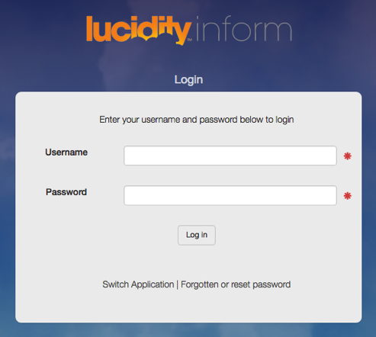
Login Directly
Login directly to InForm
using your:
Username, and
Password
OR

Slide 6
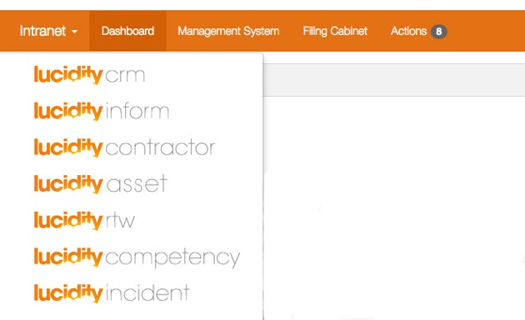
Access from another Application
Use the Switcher to change from other Applications
OR

Slide 7
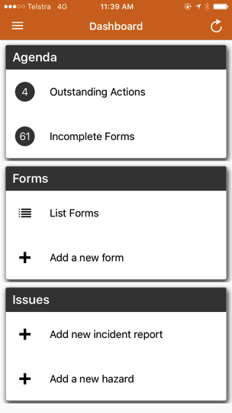
Access from the mobile App
Continue Incomplete Forms
Add a New Form

Slide 8
Using InForm
Lucidity InForm enables you to:
  complete a new form,
  open and continue completing an in-progress form, or
  Search forms you have already completed.

Slide 9
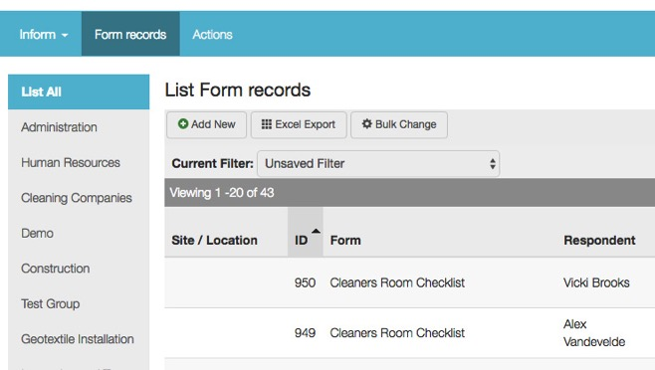
Starting a new Form
Click on Add New and select a form from the list
OR

Slide 10
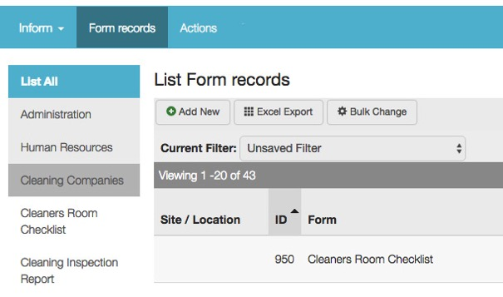
Starting a new Form
Browse Form Groups, select a form and click on Add New

Slide 11
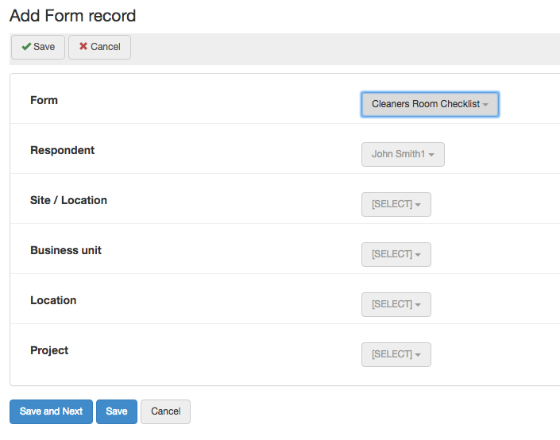
Enter admin details
Choose Admin Details from the drop-down lists
Then choose Save and Next

Slide 12
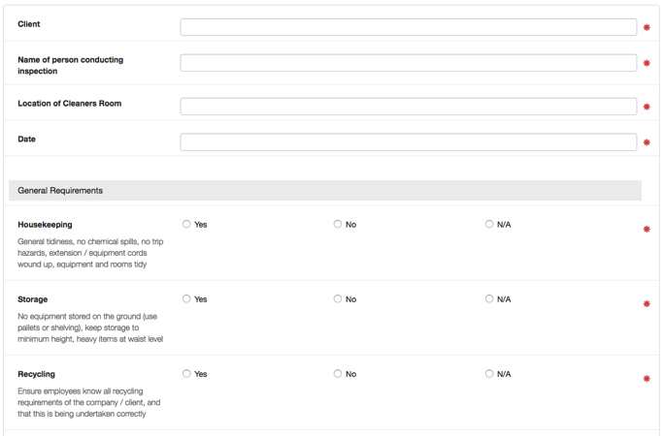
Enter form details
Complete the form details, entering information into each field
All fields marked with a red asterix
must be completed

Slide 13
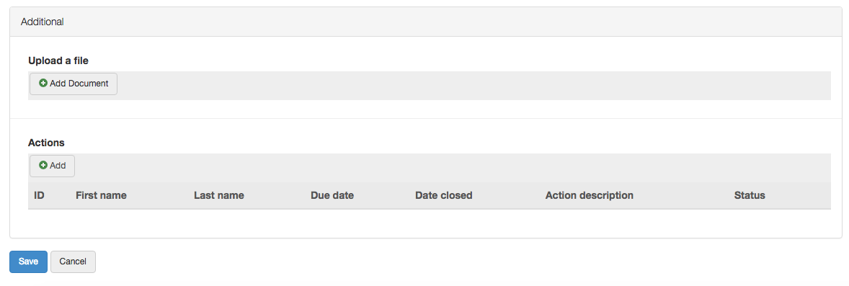
Completing the form
Add any attachments
or photos and assign any Actions
Click Save when you have finished
working on the form

Slide 14
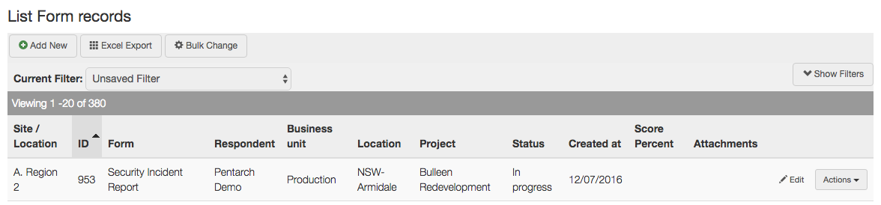
Accessing In-Progress forms
From the main page,
click Edit to continue completing any In Progress forms

Slide 15
Accessing In-Progress forms
These show as Incomplete Forms on the front page when using the App

Slide 16
THANK YOU
You have completed this training package

